Slide 1
Applications

Slide 2
What is emotional intelligence?
EQ refers to someone’s ability to perceive, understand and manage their own feelings and emotions.
Psychologist Daniel Goleman says it has five core components:
Self-awareness – the ability to recognise and understand your moods and emotions, and how they affect others
Self-regulation – the ability to control impulses and moods, and to think before acting
Motivation – being driven to pursue goals for personal reasons, rather than for some kind of reward (the opposite is external motivation)
Empathy – the ability to recognise and understand others’ motivations, which is essential for building and leading teams successfully
Social skills/ Interpersonal relationships – the ability to manage relationships and build networks

Slide 3
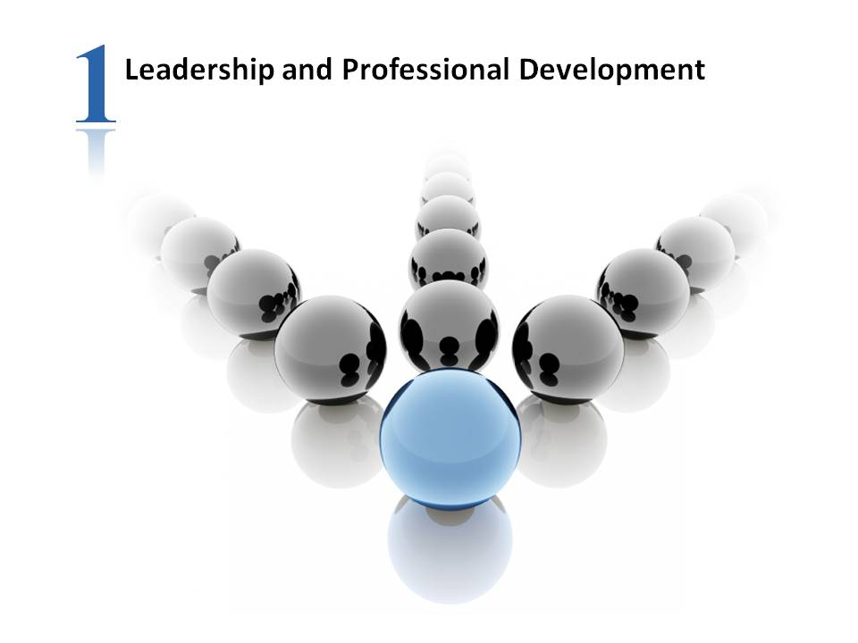

Slide 4
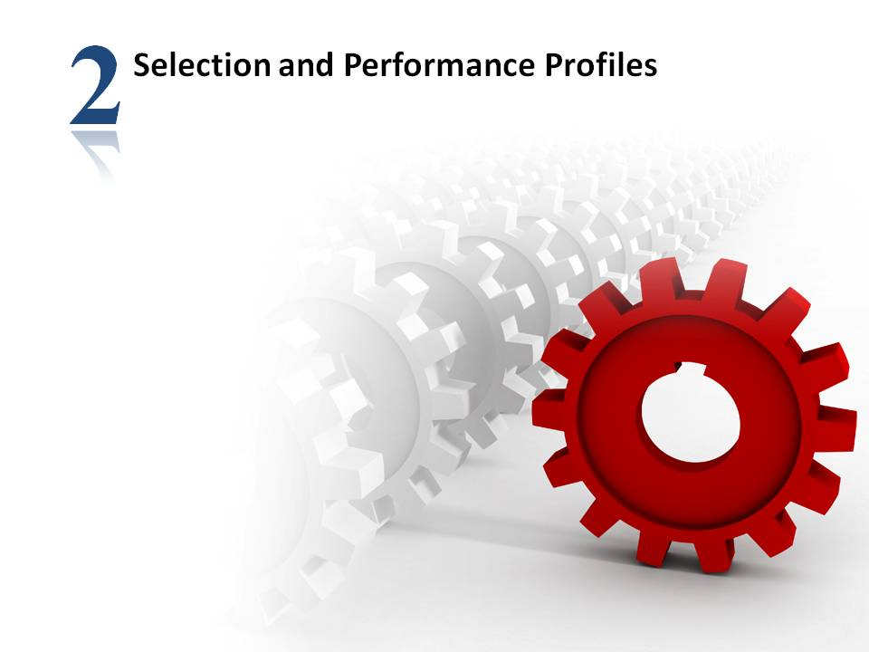

Slide 5
People with high emotional intelligence are better at motivating themselves
According to Goleman’s model, those with a higher EQ have a greater ability to self-regulate, and higher levels of motivation – which can in turn reduces their tendency to procrastinate, leads to improved self-confidence, and enables them to focus on achieving long-term goals.

Slide 6
“Businesses depend on the people who work for them to be highly engaged, to be able to adapt quickly to internal and external changes, and to show fresh thinking and come up with new ideas,” psychologist Dr Martyn Newman told People Management in 2017.
“The set of skills we need to meet these needs are rooted in our emotional and social behaviours – and studies also show that, as you grow a culture of emotional intelligence in your organisation, levels of absenteeism drop, and engagement levels increase.”

Slide 7
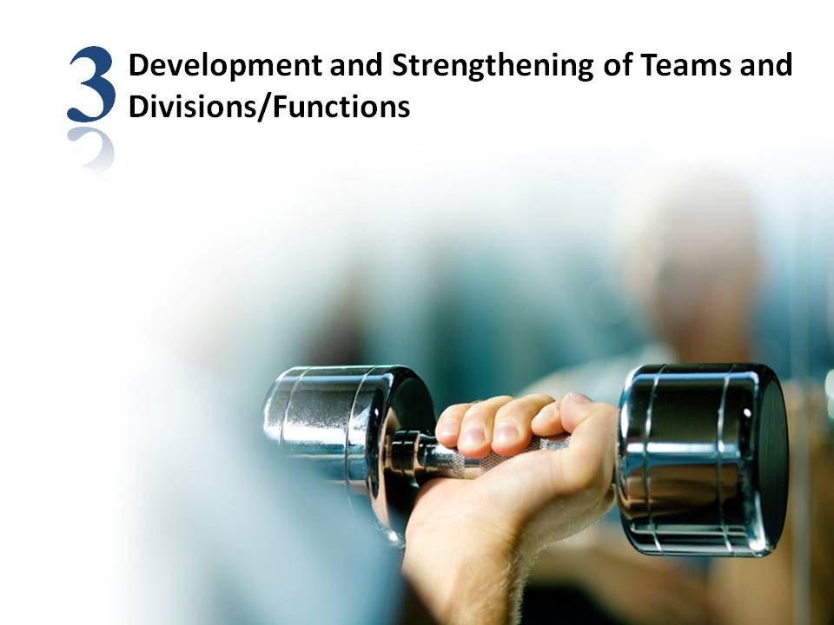

Slide 8
While leaders and managers with a higher EQ can help teams to collaborate more effectively and identify the specific drivers that motivate individual employees, teams can also develop an emotional intelligence all of their own.
A seminal 2001 study by Vanessa Urch Druskat and Steve B Wolff found that team EQ is a significant factor in determining overall performance.

Slide 9
Writing in Harvard Business Review, they said: “Our research shows that, just like individuals, the most effective teams are emotionally intelligent ones – and that any team can attain emotional intelligence.
By working to establish norms for emotional awareness and regulation at all levels of interaction, teams can build the solid foundation of trust, group identity, and group efficacy they need for true cooperation and collaboration – and high performance overall.”

Slide 10
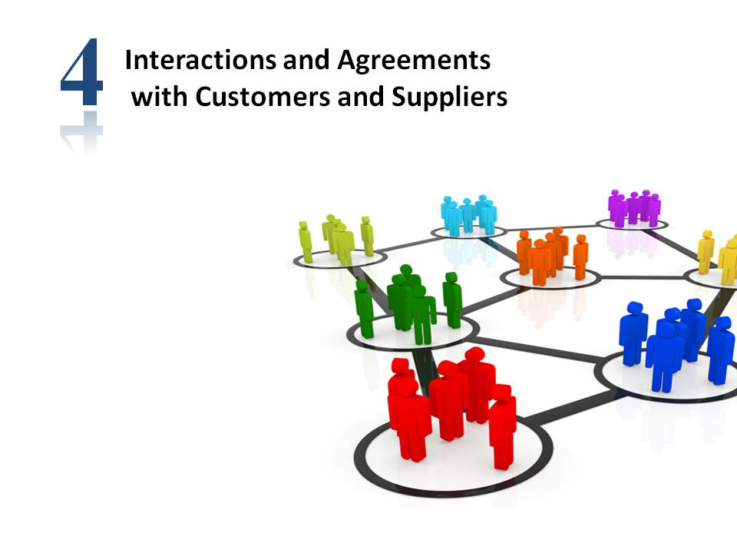

Slide 11
Emotionally intelligent workers go further in their careers
EQ affects the everyday decisions employers make, such as promoting, hiring and firing employees.
Nearly three-quarters (71%) of hiring managers surveyed by Career Builder in 2011said they valued an employee’s EQ over their IQ.
A further three-quarters (75%) said they would be more likely to promote an employee with high emotional intelligence.
More than half (59%) said they wouldn’t hire a candidate with a high IQ and low EQ.

Slide 12
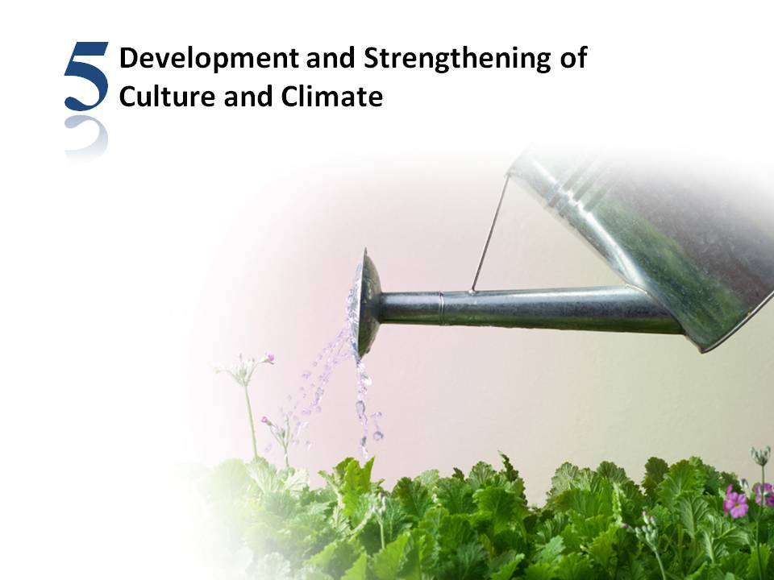

Slide 13
EQ can have a major impact on mental wellbeing
Those with a high level of emotional intelligence typically have a happier outlook on life and more positive attitude than those with a lower EQ.
They are also better at identifying and empathising with other people’s points of view – an essential trait for preventing and resolving conflicts at work.
With a better understanding of our emotions, we can communicate our feelings in a more positive manner.
We can also understand and relate to our colleagues, which can lead to better working relationships.

Slide 14
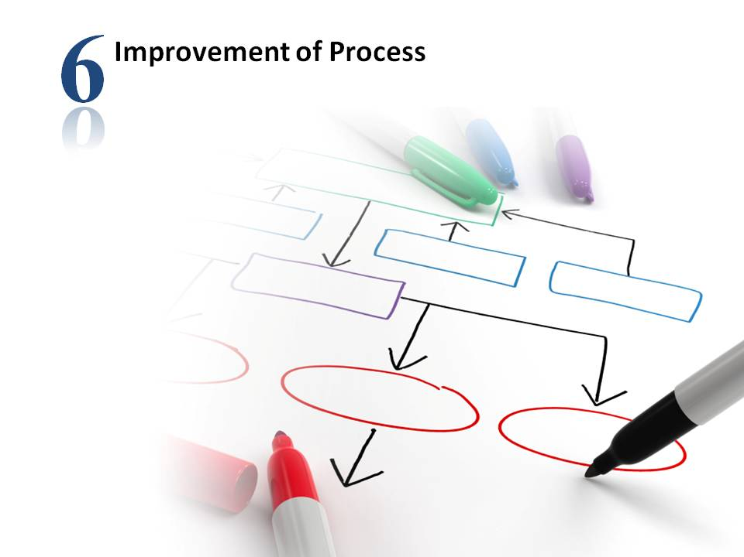

Slide 15
Emotional intelligence can also be a factor in physical health
While studies have shown links between EQ and mental resilience and wellbeing, there is less scientific evidence of the link between emotional intelligence and physical health.
But, given the impact of stress on, among other factors, our ability to sleep, exercise, and make healthy eating choices, it stands to reason that being better able to cope with the strains of daily life can have a positive impact on our physical health, too.

Slide 16
1. Organizations
2. Relationships
3. Education
4. Counselling
5. Research
6. Hospitals/Clinics
7. Everyday life

